Slide 1
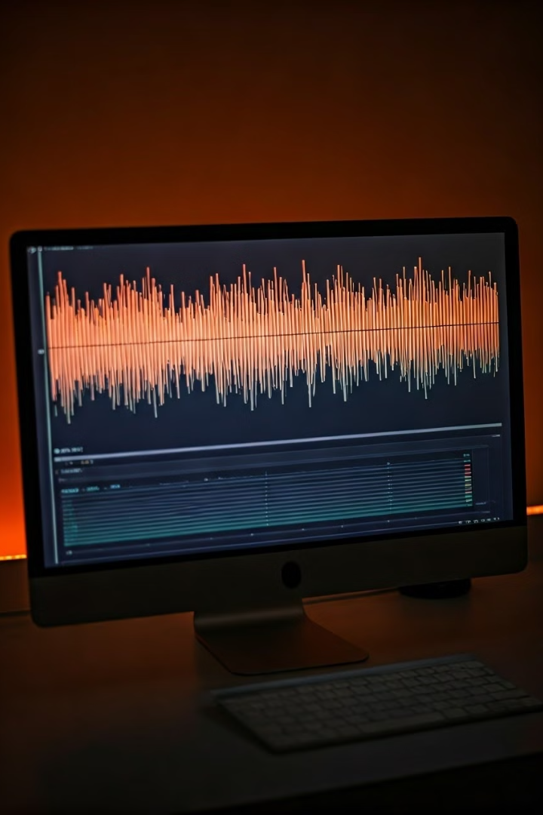

Automated AI-Powered Video and Audio Transcription
Exploring the impact of automated transcription on digital content accessibility and efficiency.
Mentor:
Moorthy Balasubramaniam
Presentation by
Meghana
Sanjeev

Slide 2
Agenda
1
Problem Statement
2
Technologies Used
3
Frontend Modules
4
Backend Modules
5
Configuration
6
APIs and Functions
7
Testing
8
Conclusion
.

Slide 3

Problem Statement
Automate Transcription
Python API
Developing an efficient and reliable system to convert spoken language from videos and audio into accurate text.
Creating a Python-based API that supports various video formats, enabling seamless integration with existing workflows.
Video Management Integration
Reliable & Scalable Transcriptions
Ensuring smooth integration with popular video management systems for easy file access and processing.
Building a robust system capable of handling large volumes of data and delivering consistently accurate transcriptions.

Slide 4

Technologies Used
1
Programming Language
2
Speech Recognition Libraries
Python, known for its versatility and rich libraries, provides the foundation for the transcription solution.
Leveraging libraries like SpeechRecognition and Vosk for accurate and efficient speech-to-text conversion.
3
Video Processing Libraries
Utilizing libraries like OpenCV and ffmpeg for video format handling and audio extraction.

Slide 5
Frontend Modules
User Interface
File Uploader
A user-friendly interface allows users to upload video or audio files, select language options, and manage transcription settings.
A dedicated module enables users to easily upload video or audio files from their devices or cloud storage.

Slide 6





Backend Modules
API Endpoint
An API endpoint acts as the entry point for client requests, receiving data and triggering the transcription process.
Audio Processing
The backend processes video files to extract audio, converting it into a format suitable for speech recognition.
Speech Recognition
The core module utilizes advanced speech recognition algorithms to convert audio into text, ensuring accuracy and context awareness.
Data Storage
Processed data, including audio and transcriptions, is securely stored in the cloud or local databases for easy access and retrieval.

Slide 7
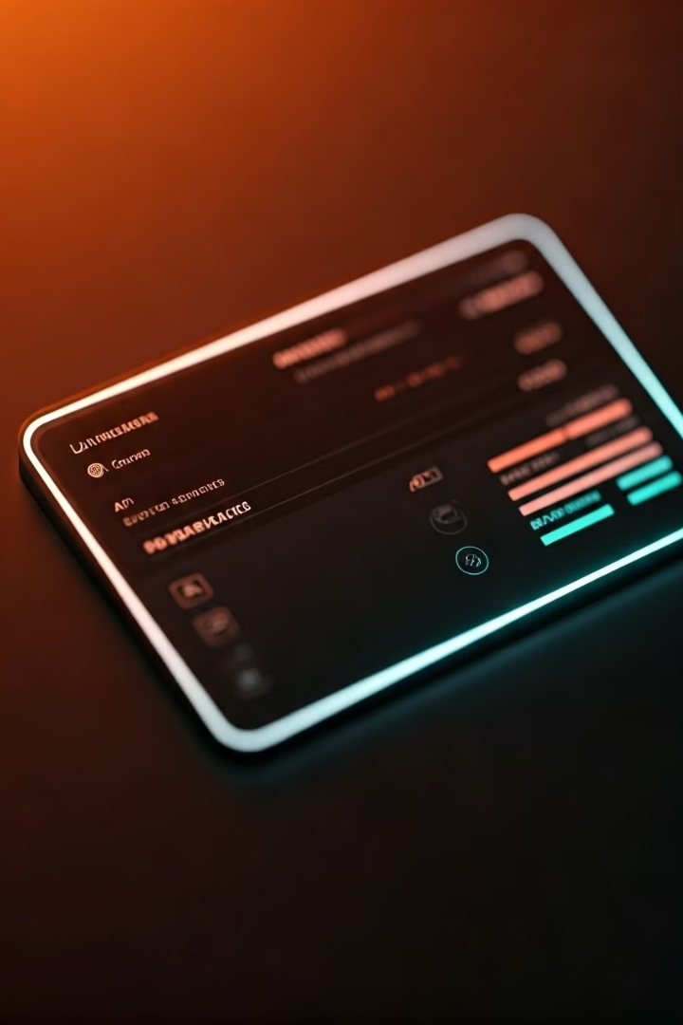
Configuration
Setting
Description
Audio Format Support
Defines the supported audio formats for processing, ensuring compatibility with various video and audio files.
API Access
Controls access to the API for external applications or integrations, providing secure and controlled communication.
Transcription Accuracy
Adjusts the level of accuracy required for transcriptions, balancing speed and precision based on specific needs.

Slide 8





APIs and Functions
Transcription API
Configuration API
Status API
Result Retrieval API
Provides access to the transcription service, allowing clients to submit video or audio files for processing.
Allows users to customize the transcription process, adjusting settings like language, punctuation, and speaker identification.
Provides real-time updates on the progress of transcription tasks, enabling users to track the processing status.
Enables users to download the generated transcriptions in various formats, such as plain text, JSON, or XML.

Slide 9

Testing
1
Unit Testing
2
Integration Testing
Individual components and functions are tested thoroughly to ensure accuracy and performance.
Various modules are integrated and tested together to verify seamless communication and data flow.
3
Functional Testing
4
Performance Testing
The entire system is tested against various scenarios and user inputs to validate its functionality and meet requirements.
The system is subjected to high-volume loads to ensure scalability and maintain optimal performance under heavy usage.

Slide 10

CONCLUSION
The AI-powered video and audio transcription solution offers a comprehensive approach to automating the process of converting spoken language into accurate text. Its advanced technology, combined with robust testing and a user-friendly interface, ensures efficient, reliable, and scalable transcription services.

